Slide 1
Microelectronic Control Systems
Lecture 1: Basic Microcontroller Programming

Slide 2
Educational objectives
During this lecture you will learn
• details about used hardware (AVR board, Atmega8)
• How to read input from a pushbutton
• How to switch LED on when button is pressed
• How to manipulate LEDs with two buttons
• Design of a program — flowcharts, differences between
→Polling
→Interrupts – in Practicals on your own

Slide 3
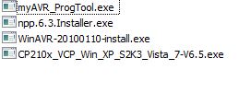
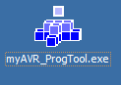
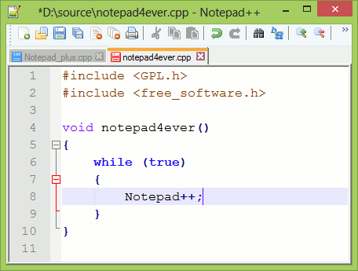
Work at home: WinAVR Toolchain
Software is available – WindowsAvrTools.zip
Programming tool myAVR_ProgTool.exe
Notepad++ Text Editor
WinAVR Toolchain
*Optional USB driver CP210x_VCP…

Slide 4
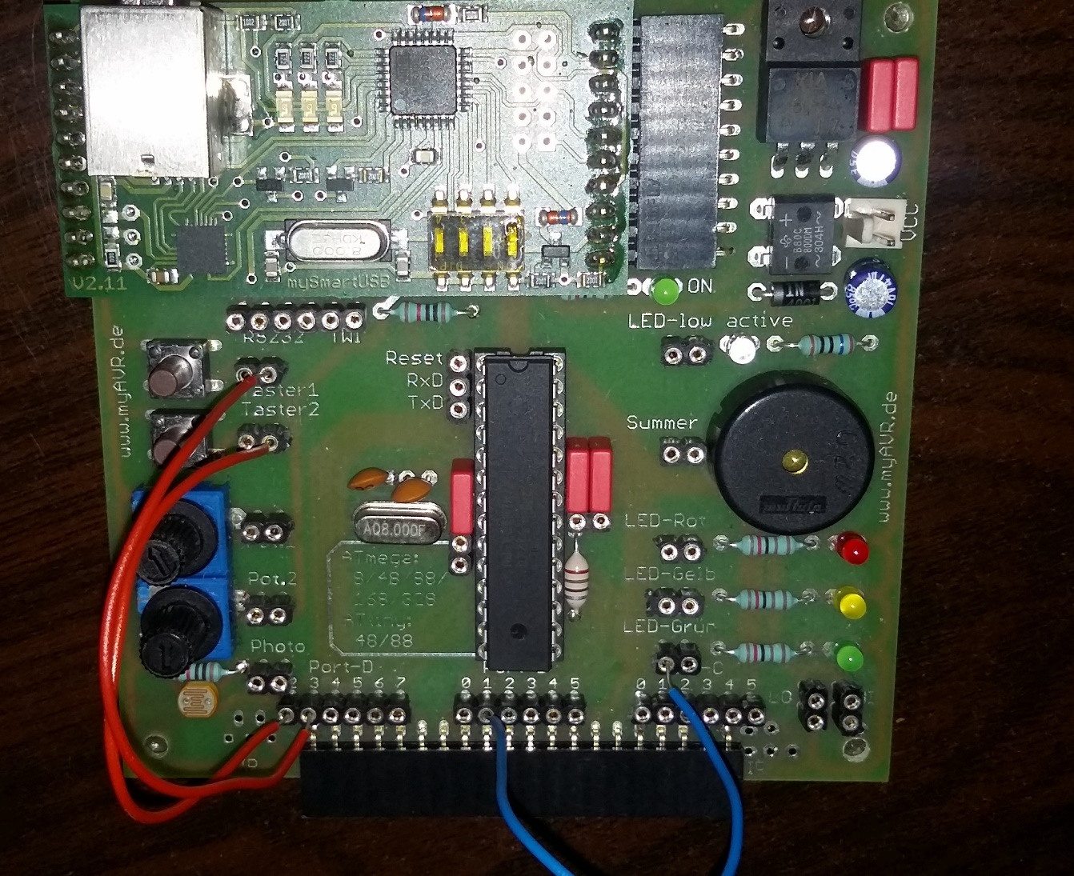
Your AVR board:
2 Buttons
3 LEDs
Port-D: 2 – 7 6 connectors
Port-B: 0 – 5
6 connectors
Port-C: 0 – 5
6 connectors
I/O Pins

Slide 5
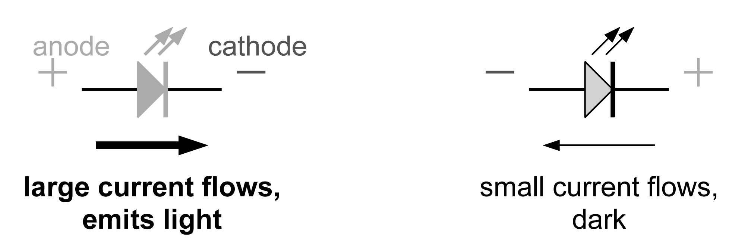
Output: Light-emitting diodes (LEDs)
Light-emitting diodes (LEDs) are the simplest type of output that can be driven by a microcontroller. From their name, they are diodes (p–n junctions in a semiconductor) that emit light.
The important feature electrically is that they are diodes. This means that they pass current only in one direction. Almost no current flows if they are connected the other way around.
The symbol for a diode is basically an arrow: current flows in the direction of the arrow. (Remember that current flows _conventionally_ from + to –.)
Prof. Dr.-Ing. Ivan Volosyak

Slide 6
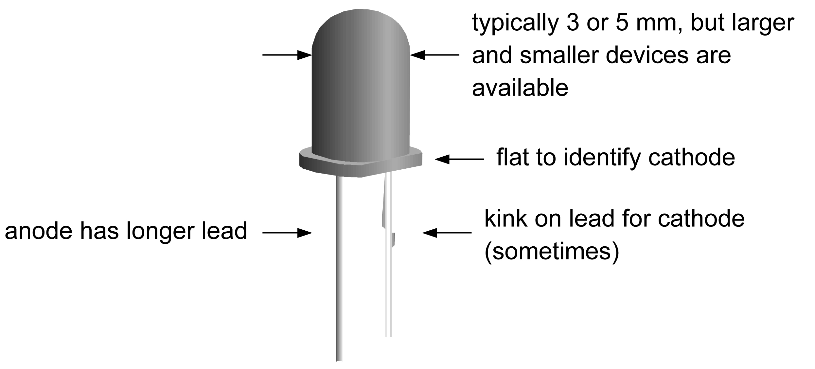
Sketch of a LED
A wide variety of LEDs is available. For many years they were red, yellow or green, but blue and white LEDs are now available. They are increasingly efficient too (need less current). The design below is the most common but there are many others.
Basic LEDs cost about 5 Cent each in bulk. You can get bicolour, tricolour, different shapes, flashing…

Slide 7
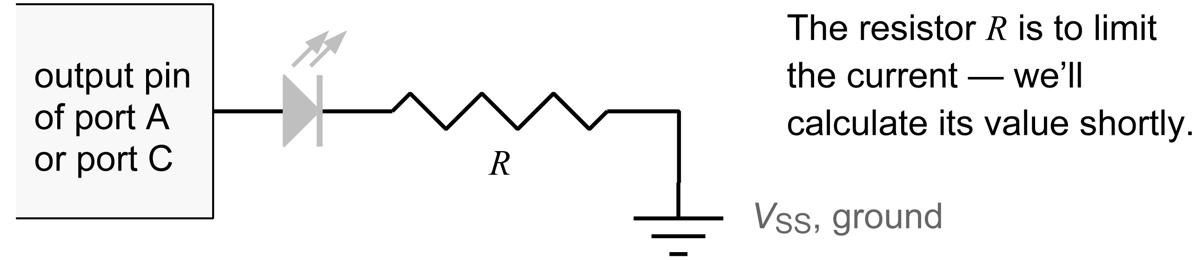
How to connect LEDs (1)
Remember that LEDs are diodes, so we must connect them the correct way around! There are two ways in which this can be done.
1. Suppose that we want the LED to illuminate when the logical value of the output is high (1) — active high.
Thus the LED should light when the pin is at VDD (supply, positive, logic 1) but not when the pin is at VSS (ground, negative, logic 0).
We therefore connect the LED between the pin and VSS.
Conventional current flows from the pin to VSS with this connection.

Slide 8
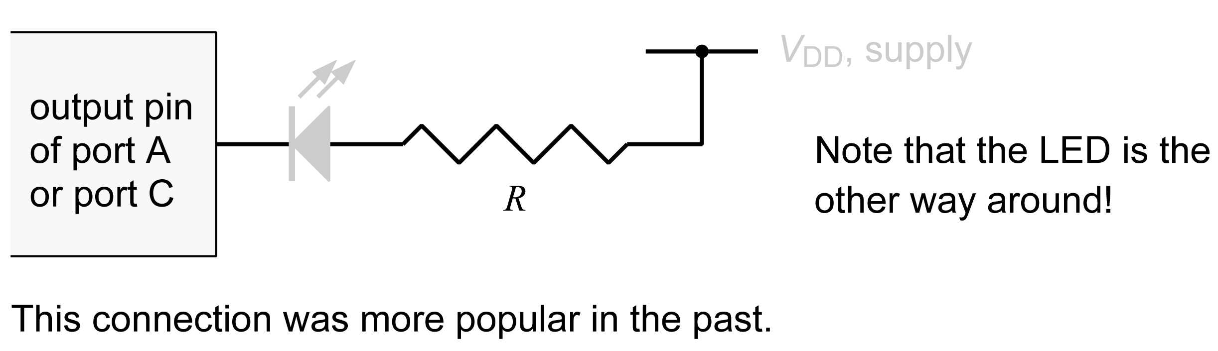
How to connect LEDs (2)
It might seem obvious that you would always want to connect an LED like this but there is a second, complementary way in which this can be done.
2. Suppose that we want the LED to illuminate when the logical value of the output is low (0) — active low.
Thus the LED should light when the pin is at VSS (ground, negative, logic 0) but not when the pin is at VDD (supply, positive, logic 1).
We therefore connect the LED between the pin and VDD.
Conventional current flows from VDD to the pin with this connection.

Slide 9
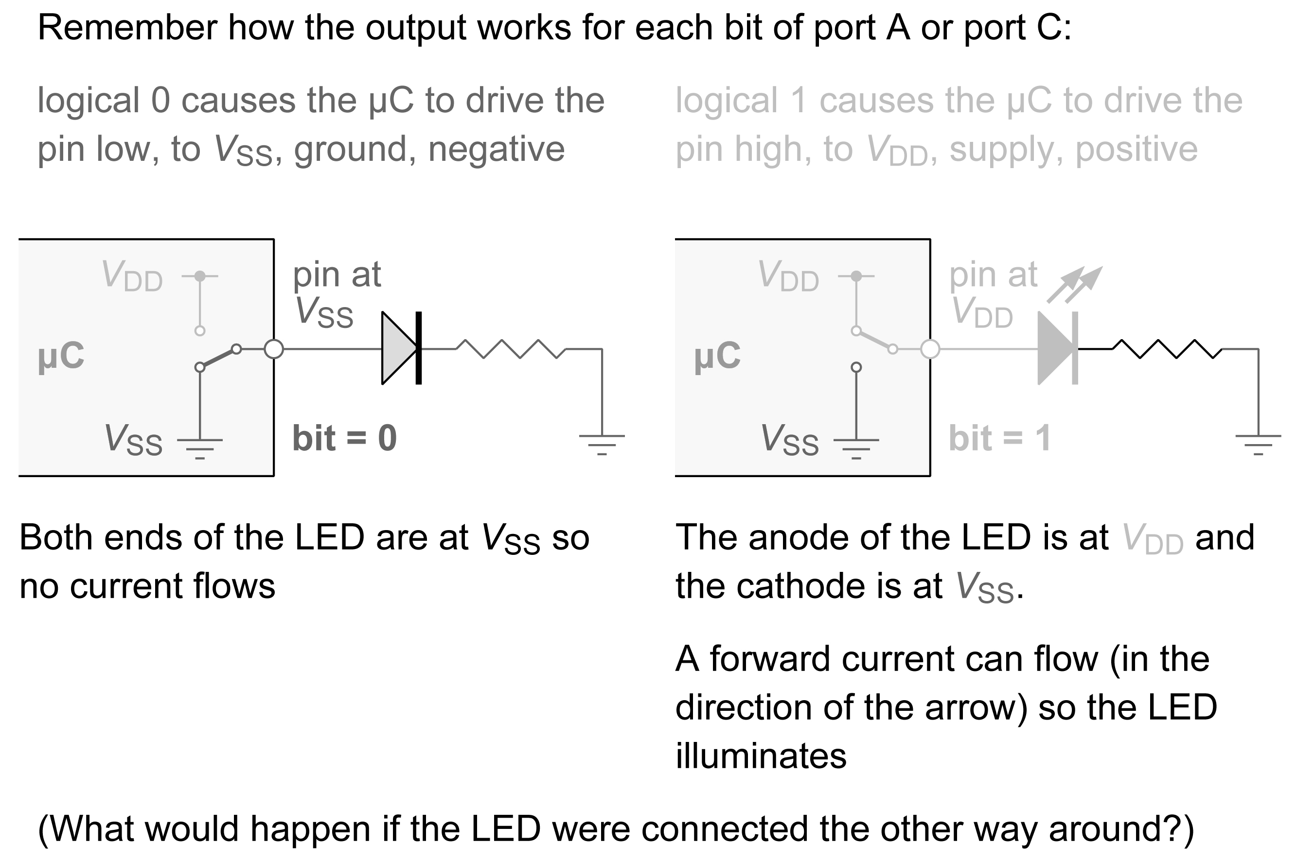
Operation of ‘active high’ LED in detail

Slide 10
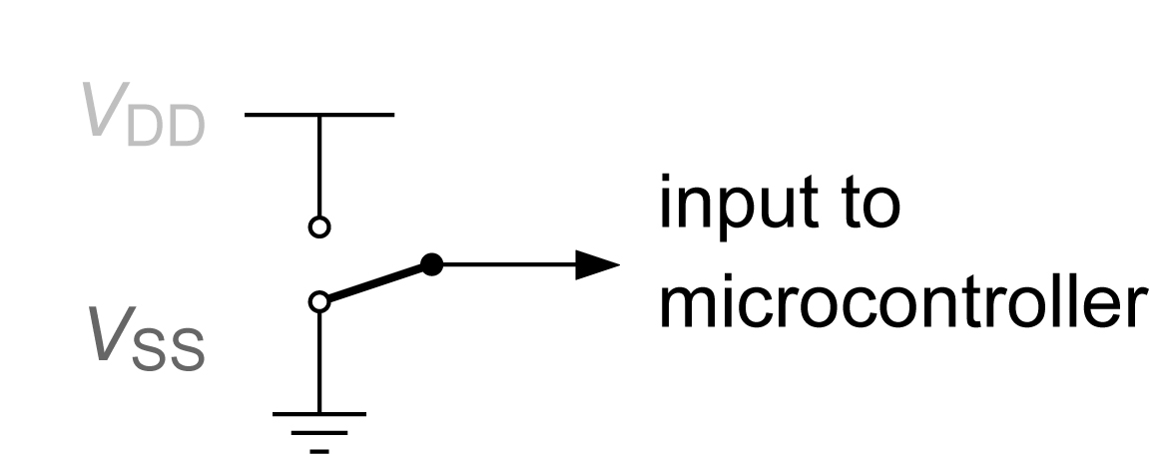
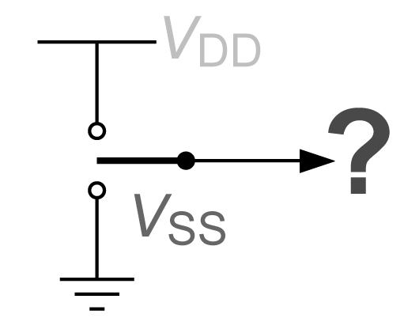
Input: How do we connect a switch? (1)
Suppose that we want to connect a simple on–off switch or pushbutton as an input to a μC. How should this be done?
The input should be either:
• VDD (supply, positive) for logic 1
• VSS (ground, negative) for logic 0
This may be the obvious approach:
However, this is not used, for several reasons:
• it needs an expensive switch (3 terminals instead of 2!)
• it needs 2 or 3 wires
• what happens while the switch is being operated?
Digital circuits must never be left with their inputs ‘floating’ (not connected)! This leads to unpredictable behaviour and possibly severe problems, very difficult to isolate.

Slide 11
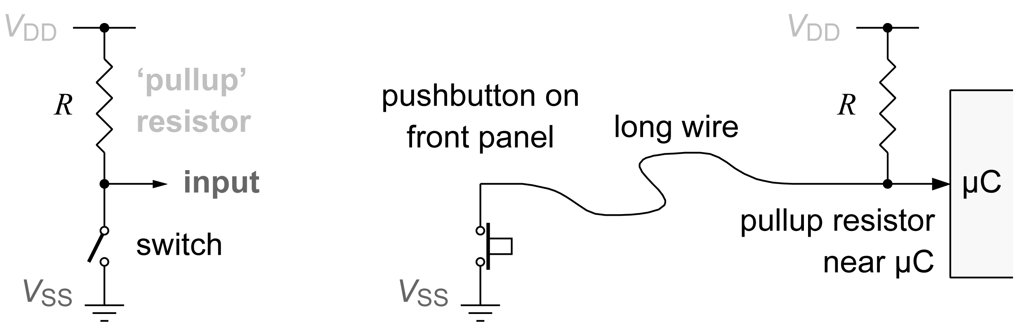
Input: How do we connect a switch? (2)
Instead, this is the circuit that is usually used. Traditionally the pullup resistor is around R » 10 kΩ.
Advantages of this circuit:
• needs only a simple switch or pushbutton
• only one wire to the switch is usually needed, because a ground connection can usually be found nearby
• the input is always connected to something

Slide 12
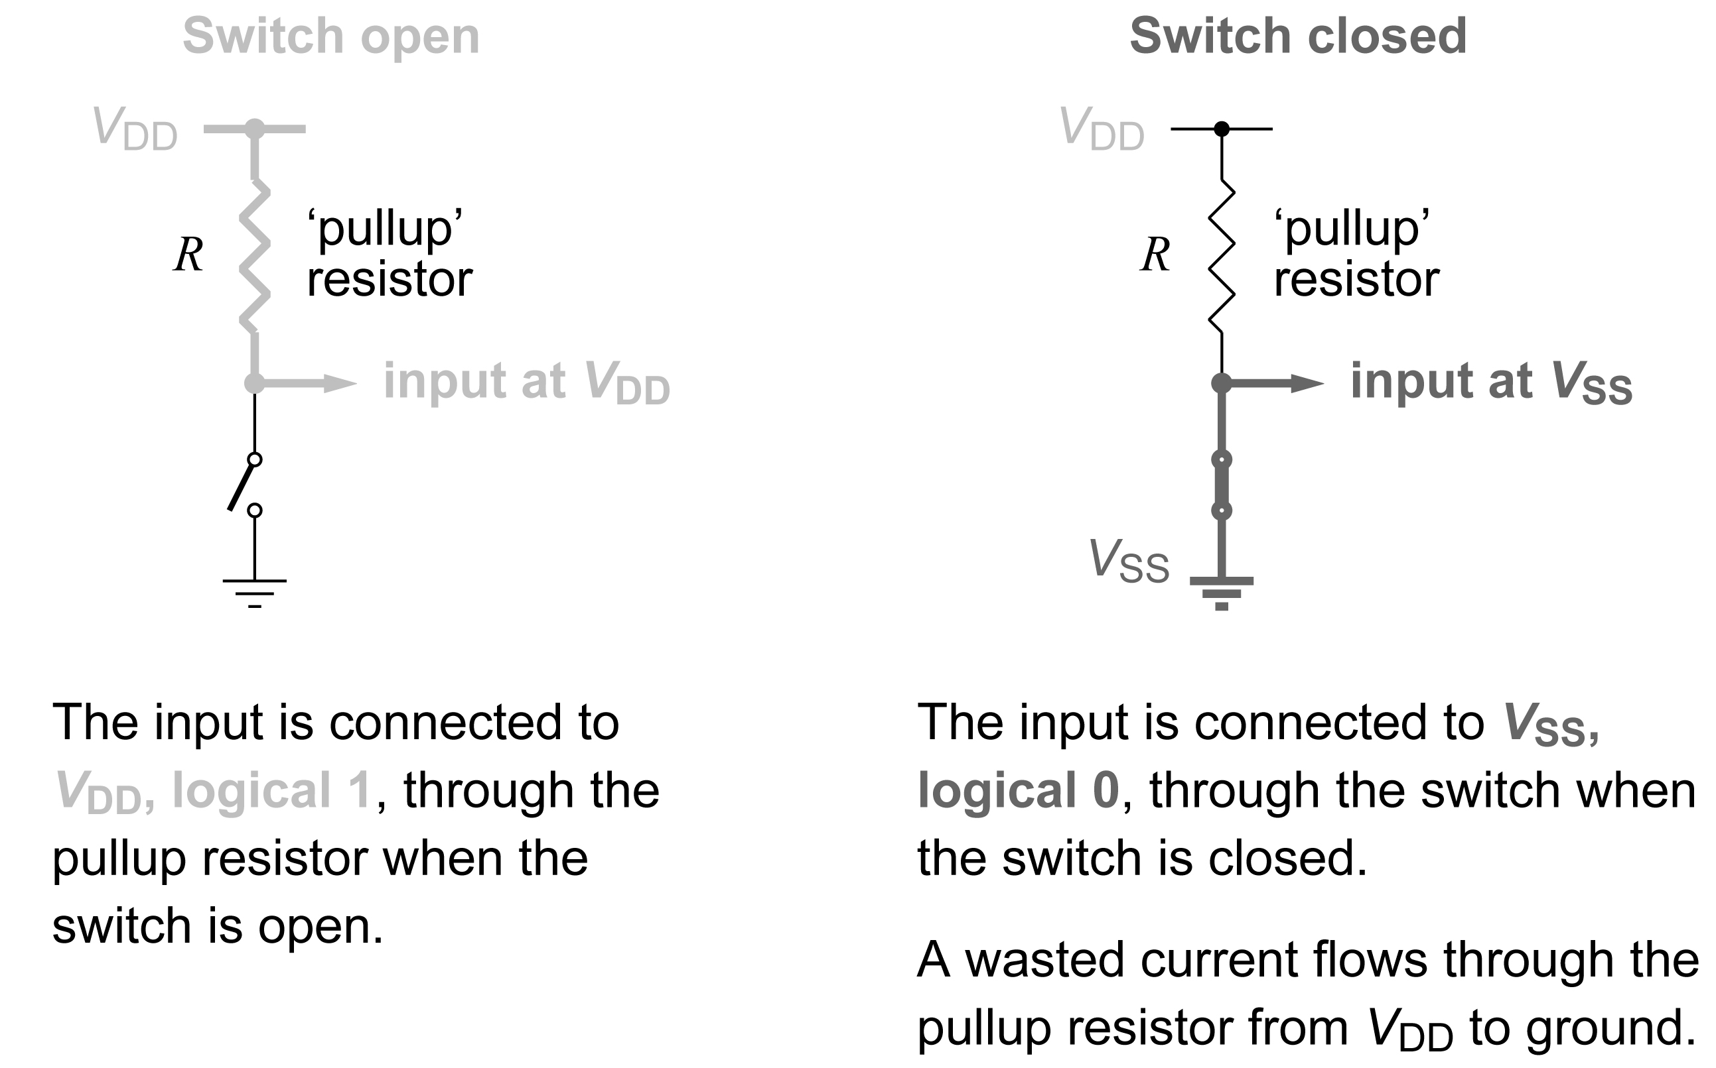
How does this work?
Input is ‘active low’ — goes from logic 1 to 0 when the switch is closed

Slide 13
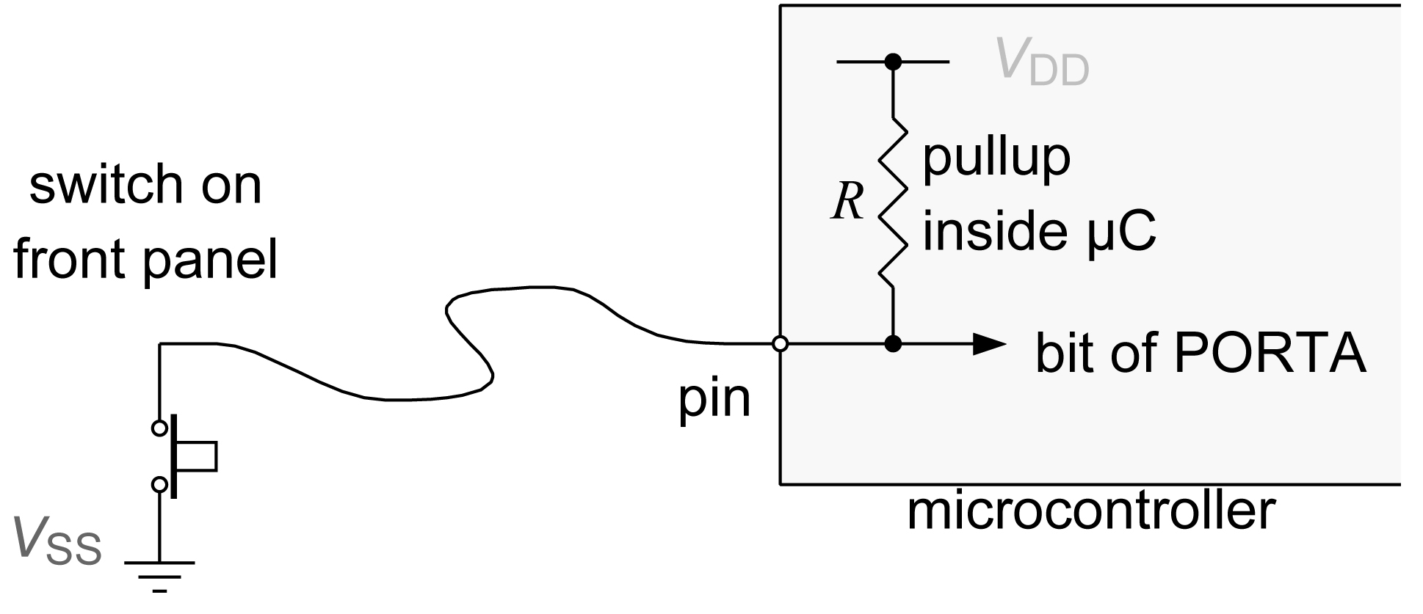
Internal pullup resistors
This configuration is so widely used for inputs that pull-up resistors are provided inside the microcontrollers. This makes the circuit really simple.
They are called ‘weak pull-ups’ because their resistance is around 10 - 20 kΩ to save current.
The pull-ups can be turned on and off individually by setting or clearing bits in register WPUA (bank 1) = called DDRX for atmega8.

Slide 14
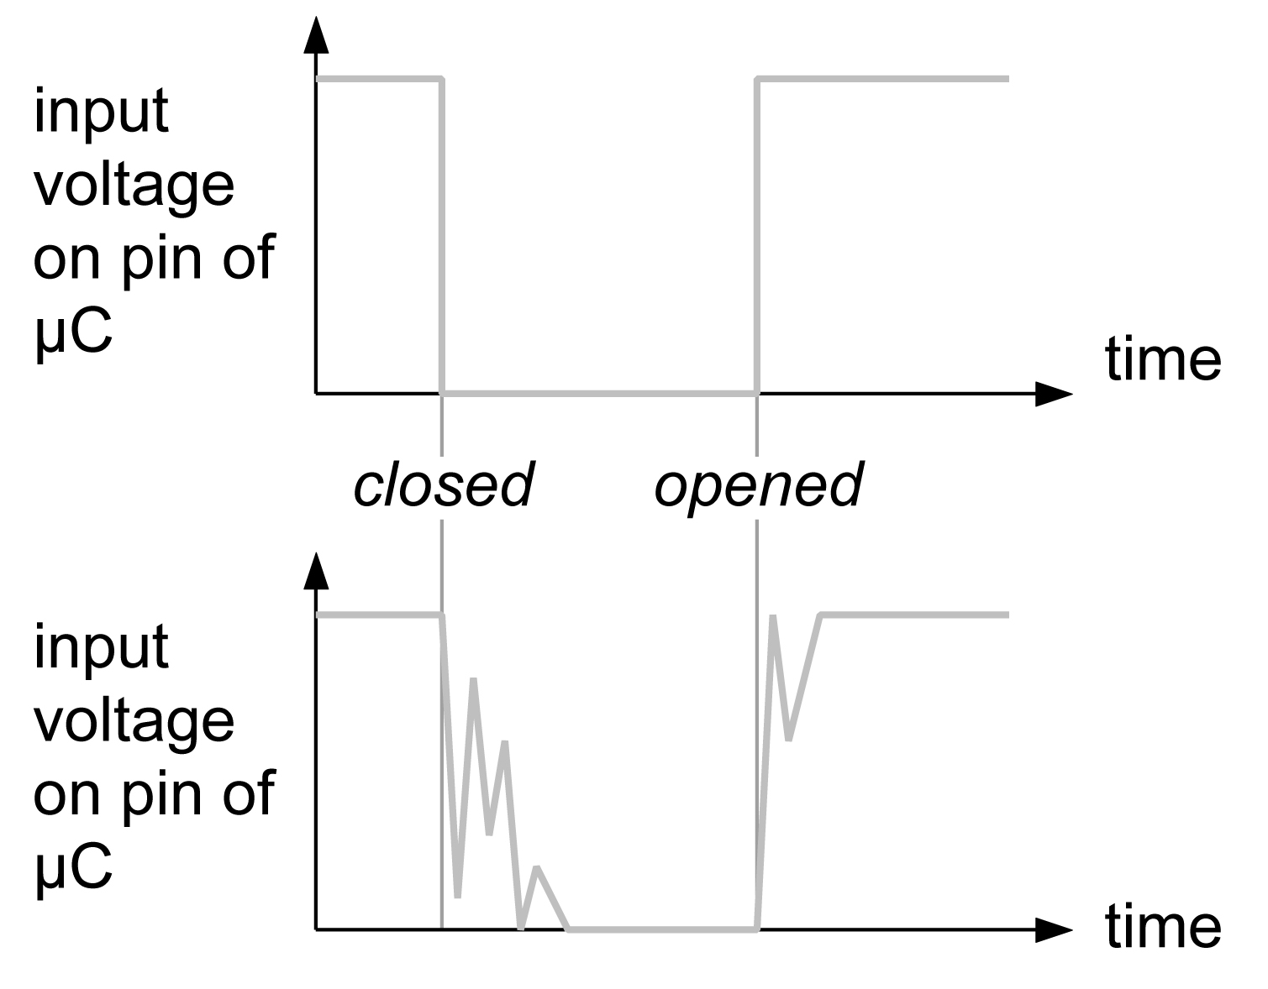
Switch bounce
We have almost finished with inputs but there is one unpleasant feature that you need to be aware of: switch bounce.
The contacts of a switch are mechanical. When the switch is operated they do not open or close cleanly but vibrate for a while. This causes the contacts to open and close several times, each time the switch is operated.
Ideal input signal
Input signal with ‘bounce’.
This typically lasts for around 50 ms. It can be eliminated by using extra components or (more usually) in software.

Slide 15
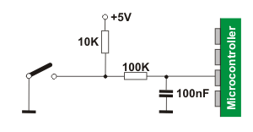
Debouncing
Problem: Buttons, as well as switches described on previous slide, are prone to signal spikes after the press. It can result in many readings per one actual click.
The possible hardware solution would be RC circuit:
Here the signal noise, which has
high frequency, is filtered by
capacitor.
However, it would be a lot easier if we can solve the problem in the software!

Slide 16
Debouncing
As said, the whole process is lasting up to about 50 ms (it depends on the quality of the used switch), so the simplest solution is to stop reading the signal for the 50 ms after the event.
What C command allows you to wait for 50 ms? When must we call this command?
Please write down your version of the code for this! (assume that button is connected to PB2, and per press you want to switch on and off the LED connected to PB3).

Slide 17
Debouncing
Example of the code:
if( ~PINB & 1<<PB2)
{
_delay_ms(50);
PORTB^= 1<<PB3
}

Slide 18
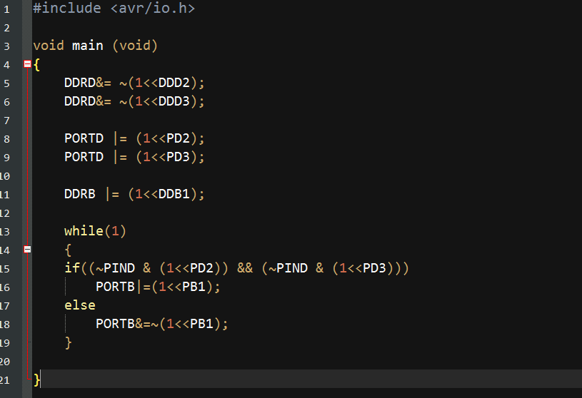
Given code analysis
Start with a given code:

Slide 19
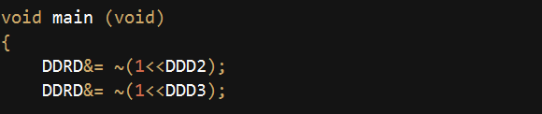
Given code analysis
Let us discuss the code line by line.
void main (void)
{
main is the name of the function any program must have. Program executes the main function, and other functions are used only if function main() calls them!
DDRD stands for Data Direction Register D. Firstly, notice that AVR board has 3 groups of DIO pins: D, B, C.
This is where letter D comes from in the name of the register.

Slide 20
Given code analysis
Let us discuss the code line by line.
What is a Register? It is a part of the memory the device has. But it is not just a memory for any information: every register has very specific function, which is always hinted by the name of the register. All registers in Atmega8 are 8bit long (0000 0000 – 1111 1111)

Slide 21
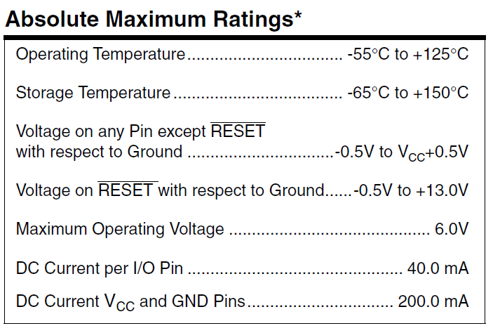
Given code analysis
What function could a Data Direction Register fulfill?
Data direction register determines the behaviour of I/O pins. A pin can be either a sensitive element that will take it‘s voltage level from the wire you connect to it (input), OR it can do something completely different – it could give out some voltage, and force it onto any wires you connect (output, remember: we have a microcontroller here and it can „drive“ not so much, limited to about 25 mA of current.)
Page 242 of atmega8.pdf

Slide 22
Given code analysis
Let us further discuss the code line by line.
So, buttons are connected to pins D2 and D3. Should we have corresponding pins as inputs or outputs to „sense“ if button is pressed or not?
→ Of course, as inputs!

Slide 23
Given code analysis
Let us further discuss the code line by line.
Definetely if we want to sense buttons, we need inputs!
How does the code accomplish it?
1 << DDD2 – places a 1 to the position corresponding to D2 pin: DDRD = 0000 0100
~( A ) – inverts the variable A , all 0‘s become 1‘s and vice versa: → 1111 1011
B &= C – bitwise AND, which will keep the value of the bits in B, if C has a 1 at their position and make them 0 if C has 0 in their position. C is a so-called mask.

Slide 24
Given code analysis
Let us further discuss the code line by line.
→ How does the code accomplish it?
The code puts 0 in the bits of DDRD corresponding to D2 and D3 pins.
Why 0?
Because specification says that zeros in DDRs are for input!

Slide 25

Given code analysis
Let us further discuss the code line by line.
What is PORTD?
We discussed that pin can be either Input or Output.
For output, we must have a place in memory defining what to output, 1 or 0. This place is called PORT. And D stands for D group of pins = register.

Slide 26
Given code analysis
Let us further discuss the code line by line.
Wait, but we are already using D pins (D2 and D3) for the buttons, right? We use those pins as inputs!
What will PORT do, cofigured as an input? It will define the future „default“ value, the one that input will hold when disconnected.
More about this behaviour later.

Slide 27
Given code analysis
Let us further discuss the code line by line.
PORTD |= (1<<PD2);
The code used bitwise OR |= to ensure 1 in the position corresponding to PD2.
In fact, the button is „disconnected“ when it is not pressed, and when you press it you close a contact supplying low voltage to the connected pin.
= „active low“ from the previous slide 12

Slide 28
Given code analysis
Let us further discuss the code line by line.
So you know what DDR is. Pin 1 of the group B is used for LED in our program.
To drive LEDs, we need output. Here we use bitwise OR |= again to set one bit of a register to 1 (=high).

Slide 29
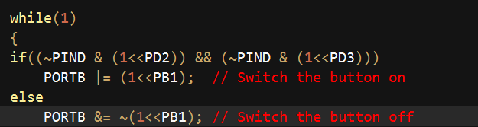
Given code analysis
What do we see next?
While(1) – this is a infinite loop, which will never exit. What is contained within curly brackets is what your microcontroller will do forever. Or before you unpower or reset it.
if( expression )
This is a conditional. It will choose which command to execute depending on the value of the expression within the brackets.

Slide 30
Given code analysis
if( (~PIND & (1<<PD2)) && (~PIND & (1<<PD3)) )
The whole expression within the brackets will be evaluated to either true or false. This expression will be true if both buttons are pressed.

Slide 31
Given code analysis
if( (~PIND & (1<<PD2)) && (~PIND & (1<<PD3)) )
The expression could be further subdivided into conditions for single buttons:
(~PIND & (1<<PD2))
(~PIND & (1<<PD3))
And logical AND operator between them: &&

Slide 32
Given code analysis
Let us discuss how condition for one button is formed:
(~PIND & (1<<PD2) )
So the PINX is a register where the values from inputs will go. PIND contains values for possible 6 pins (see slide 4). We specify which specific button is of interest to us by doing & (1<<PD2)
All other bits of this register will not influence the value of the expression.

Slide 33
Given code analysis
The ~ operation is negation, which we already seen.
As we discussed, actual pressing of the button connects low voltage to the pin.
However, we want a „positive“ statement, so that we have 1 (true) for button pressed. Therefore we invert the value of the whole PIND; remember – we only invert a copy of it, not the actual register, and we already took care to read the right pin out of 6.

Slide 34
Given code analysis
An if conditional and statement for true value is followed by else keyword, which specifies what actions will be taken if expression is executed to false.

Slide 35
Given code analysis
The actual switching on and off of the LEDs are done in the lines:
PORTB |= (1<<PB1); // Switch the LED on
PORTB &= ~(1<<PB1); // Switch the LED off
As already discussed, PORTX is used to determine the output value (ON/OFF) for an output pin. The syntax is just like the one used before to set default values for the inputs.

Slide 36
Independent Task 1: Invert behaviour
When we talk of the behaviour, we mean the active part of the program.
At the moment, the program waits for user to press BOTH buttons.
As long as buttons are pressed, the LED is ON. Otherwise it is OFF.

Slide 37
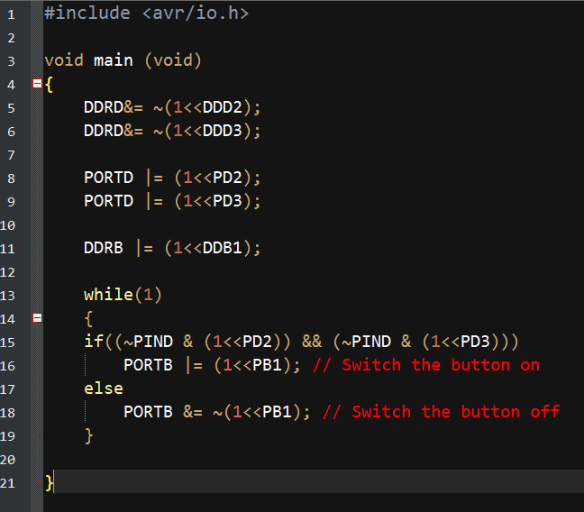
Independent Task 1: Inverting behaviour
….As long as buttons are pressed, the LED is ON. Otherwise it is OFF.
How do we see it? &= ~ can only make something off (=set to low, or „reset“of some bit).
|= can only make something on (set to high, or „set“ some bit).

Slide 38
Independent Task 1: Invert behaviour
Keywords if(„condition“) and else represent some conditions for actions to be taken. To invert behaviour, just swap the actions!!!

Slide 39
Independent Task 2: 2nd LED
New task is to make an indication for another condition:
Either button one or button two are pressed.
Before we worked with a condition for BOTH buttons to be pressed:
if( (~PIND & (1<<PD2)) && (~PIND & (1<<PD3)) )
It consists of:
Button one is pressed: (~PIND & (1<<PD2))
Button two is pressed: (~PIND & (1<<PD3))
Logical AND between them: &&
Parenthesis to encapsulate the whole condition as one ( … )

Slide 40
Independent Task 2: 2nd LED
Either button one or button two are pressed.
….
Button one is pressed: (~PIND & (1<<PD2))
Button two is pressed: (~PIND & (1<<PD3))
…
What logical operator do we need to indicate „Either one of two conditions“?
Logical OR: ||
Therefore, the behaviour of new LED will depend on condition
( (~PIND & (1<<PD2)) || (~PIND & (1<<PD3)) )

Slide 41
Independent Task 2: 2nd LED
So, we know what logical condition will we use.
What steps must be done?
Connect one more Digital I/O pin to LED
Set this pin to Output in your code
Make a copy of the whole content of your while(1) loop
In a copy: change logical condition to ( (~PIND & (1<<PD2)) || (~PIND & (1<<PD3)) ), as well as pin number!
We could also swap the ON/OFF actions again in the copy: this way a YES answer will correspond to light on, and NO to no light.
Compile your program and see if it works!

Slide 42
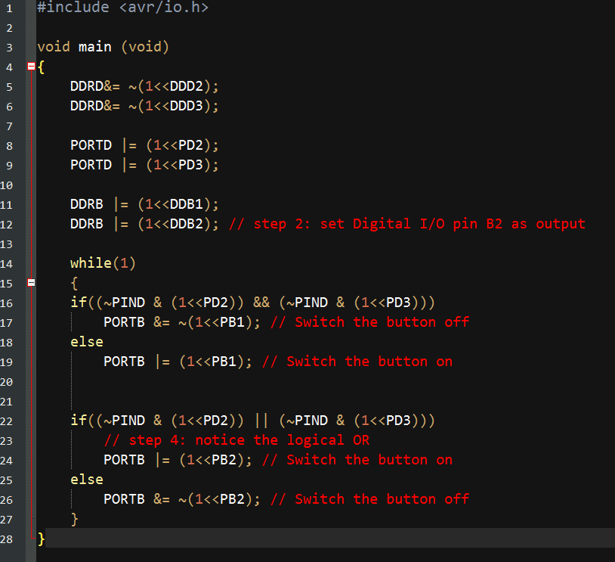
Independent Task 2: 2nd LED
If you are experiencing a problem, compare your code with this:

Slide 43
Independent Task 3: 3nd LED, XOR
XOR is so-called exclusive OR: It is true then, and only then, if one bit is true and another false. The easiest way to check it is: if (a!=b), „if bit a is not equal to b“.
So the new condition should unite the condition for button 1 to be pressed with condition for button 2 using != operator.

Slide 44
Independent Task 3: 3nd LED, XOR
So, we know what logical condition will we use.
What steps must be done?
Connect one more Digital I/O pin to LED
Set this pin to Output in your code
Make one more copy of the condition/action block in your while(1) loop.
In a copy: change logical condition to ( (~PIND & (1<<PD2)) != (~PIND & (1<<PD3)) ), as well as pin number!
Ensure right ON and OFF actions.
Compile your program and see if it works!

Slide 45
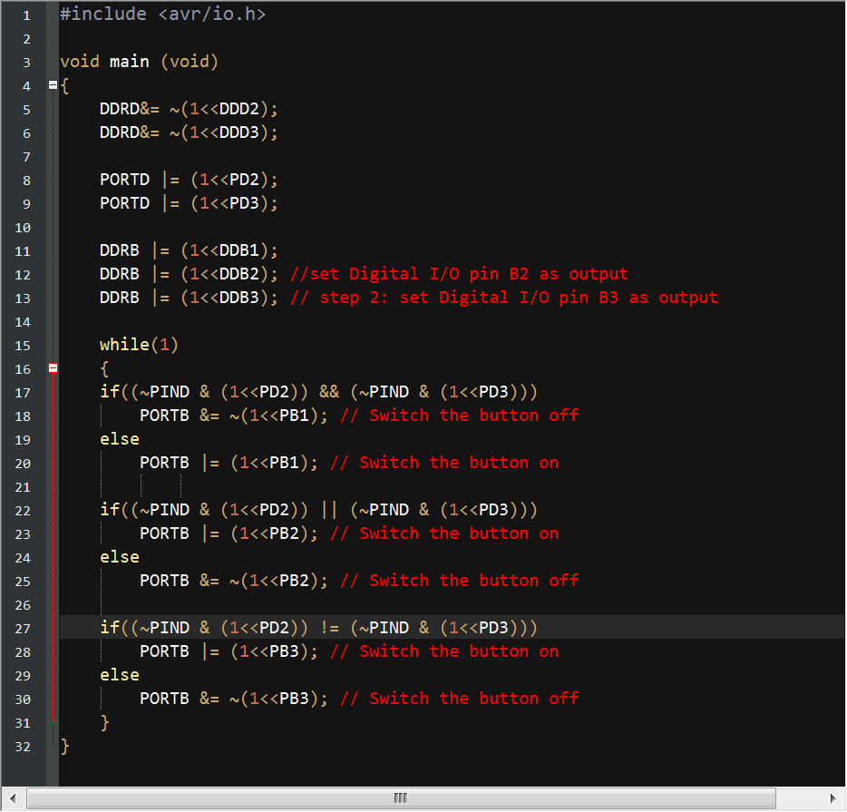
Independent Task 3: 3nd LED, XOR

Slide 46
How does a μC know when to respond to an input?
There are two opposite ways of handling this. Suppose that I am writing
lectures at home one evening while waiting for my wife to return. (She
has lost her key so I need to unlock the door for her). I could do two things:
• I go and check to see if she is waiting outside the door after every
page of notes. This is called polling.
• I carry on writing lectures until interrupted by the door bell. I finish the sentence in my lecture notes so that I can resume them easily, and
only then go to let her in. Afterwards, I return to writing lectures.
These two methods are widely used and have advantages in different
circumstances. (The choice is clear for this example!)
• Polling is simpler to program because everything is predictable, and is
more efficient for handling frequent events.
• Interrupts are tricky to program because we must ‘tidy up’ before
handling the interrupt and resume normal working smoothly
afterwards, but are more efficient for infrequent events.

Slide 47
Light an LED when a button is pressed - recapitulation
Here is the simplest task where a μC needs to respond to its input:
• light an LED on pin PB1 when a pushbutton on PD2 is pressed
You have done this in the laboratory with a few lines of C.
#define F_CPU 8000000 UL
#include <avr/io.h>
int main (void)
{
DDRD &= ~(1 << DDD2);// PD2 as Input PORTD|= (1 << PD2); // Pullup PD2
DDRB |= (1 << DDB1);// PB1 as Output
while(1)// Infinite loop
{
// Read pin status of PIN PD2
if ( ~PIND & (1 << PD2) )
{
PORTB =(1 << PB1);
}
else
PORTB =0;
}
return (0);
}
This is effectively polling the input every time the program goes around the
loop.

